Slide 1
Gordon Thomas Honeywell 2017 DNA Database Hit of the Year Award
Presented by Tim Schellberg, President
Gordon Thomas Honeywell, Governmental Affairs
HIDS Conference - Vienna, Austria - May 17, 2017

Slide 2
DNA Databases
Powering Criminal Investigations Globally
OVER 85 MILLION
reference samples
55 COUNTRIES
with national DNA database programs
70% HIT RATE
possible for robust systems

Slide 3
DNA Database Hit of the Year
Recognition
Awareness
Promotion

Slide 5
Selecting the Winning Case
Global Announcement
Criteria:
Cold hit against a reference database; and
Hit or a conviction within the last 24 months
Sent to Forensic DNA and Police Communities
Over 50 Cases from 15 Countries
Top 10 cases presented by GTH to 7 judges
5 Finalists selected, discussed and evaluated by judges
2nd Place received 3 votes
1st Place received 4 votes

Slide 6
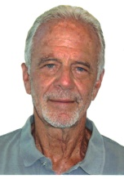
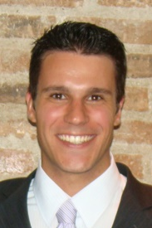
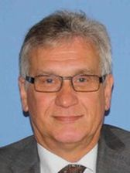
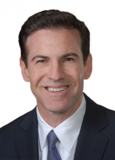
2017 Hit of the Year Judges
Rock Harmon (retired)
Senior Deputy District Attorney
Alameda County District Attorney’s Office
California, United States
Guilherme Jacques
Forensic Scientist
National Institute of Criminalistics (Federal Police)
Brasilia, Brazil
Dr. IR.C.P. (Kees) Vanderbeek - MBA
Custodian Dutch DNA Database
Netherlands Forensic Institute
The Hague, Netherlands
Detective Sergeant Joe Blozis
Forensic Investigations Division
New York City Police
New York, United States
Vanessa Lynch
Founder and Executive Director
The DNA Project
Cape Town, South Africa
Lorna Santos
Chief
PNP Crime Laboratory DNA Branch
Philippines National Police
Manila , Philippines
Tim Schellberg
President Gordon Thomas Honeywell Governmental Affairs
Washington State, United States

Slide 7
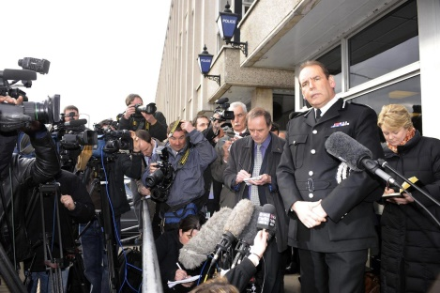
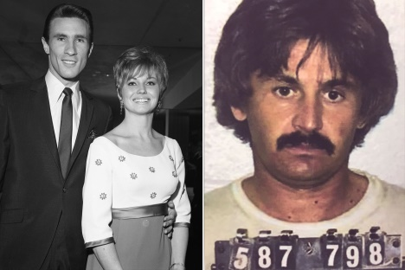
Common Themes: Old Cases and Familial Searching 18 of 50 cases were unsolved for at least ten years 8 cases had hits resulting from familial searching
1981 Rape in West Yorkshire
West Yorkshire, UK
Arrest made January 2016
“Operation Recall” to solve cold cases
“Composite Likelihood Ratio” process utilized – suspect moved from number 151 position to number 3 position
Convicted August 2016
1976 Rape and Murder
of Karen Klaas
Hermosa Beach, California, USA
Hit occurred January 2017
Victim’s husband was Bill Medley of “The Righteous Brothers”
Suspect died in 1982, but coroner had DNA to confirm familial lead

Slide 8
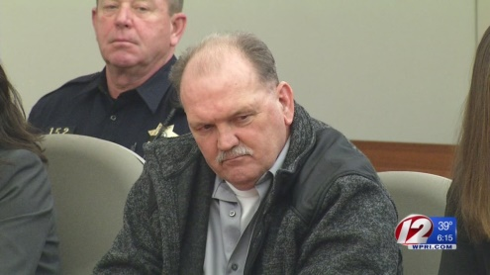
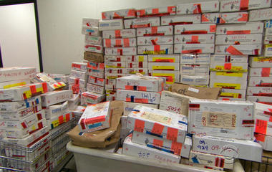
Common Themes: Unsubmitted DNA Evidence in Serious Cases Hundreds of thousands of untested rape kits in the USA alone Mandatory old and new rape kit testing policies are spreading across the USA
1990 Rape and murder of 85 year old Germaine Mouchon
Warwick, Rhode Island, USA
Hit occurred November, 2015
Grandson of victim pushed police
to reopen case and test old
evidence
Convicted September 2016
2002 Rape of a woman
Memphis, Tennessee, USA
Hit occurred July, 2016
Over 12,000 untested rape kits reported in Memphis, Tennessee
Case involved identical twin suspects
Suspect awaiting trial

Slide 9
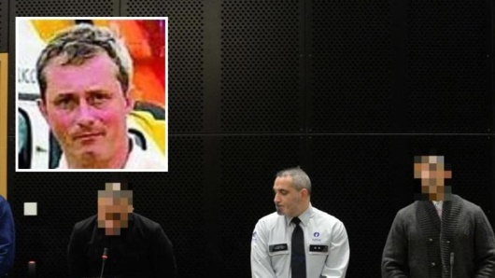
Interjurisdictional Database Matches Criminals are mobile Interpol, Prüm, and the US CODIS networks proving successful
2011 Murder
of Marc Meunier
Belgium
Hit occurred January 2017
Hit occurred to French database
Convicted early 2017
Common Themes:
2016 Rape of
70 year old woman
Lommendalen, Norway
Hit occurred in 2016
Hit occurred in Austria’s database
Suspect awaiting trial

Slide 10
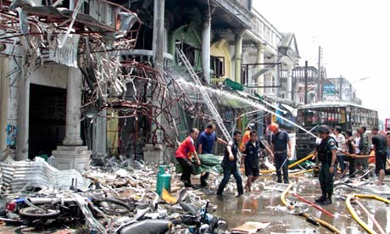
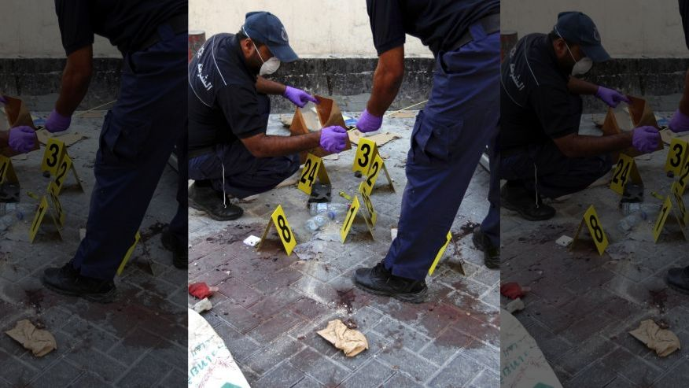
Police and Military Relying More on DNA for Terrorism Cases
Military raids produce numerous matches to suspects and cold cases
Southern Thailand (2013)
Bombing suspect identified from touch DNA on explosive materials
Bahrain (2015/2016)

Slide 11
The Five Finalists
China
Florida
New York
Austria
Italy

Slide 12
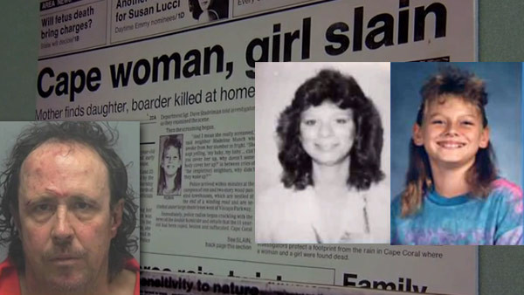
1990 Rape and Murder of Robin Cornell and Lisa Story Cape Coral, Florida Hit occurred September 2016
5th Place Case
Database hit the result of arrestee testing law in Florida
Vicky Bellino, FDLE DNA Analysist and CODIS Manager: “I would like to explain why this case is important to me…”
Suspect awaiting trial.

Slide 13
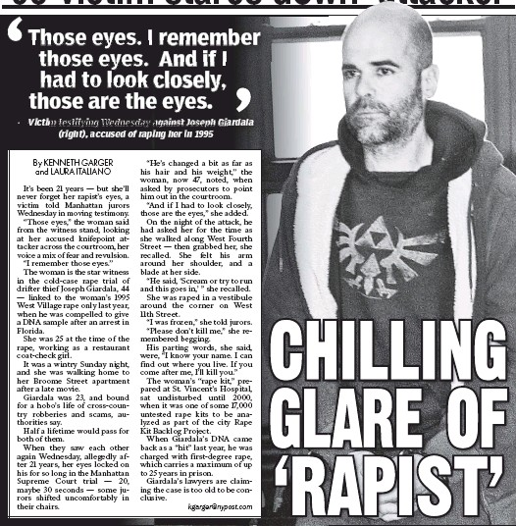
1995 Rape New York City, New York, USA Hit occurred May 2015
4th Place Case
Rape kit became part of 17,000 Rape Kit Backlog problem in New York City
John Doe Warrant Strategy
Interstate CODIS match with Florida after arrest for minor crime
Case was inspiration for $38 million grant program to test rape kits
Convicted June 2016
Cyrus Vance,
New York City
District Attorney (Manhattan)
New York Post, June 8th 2016

Slide 14
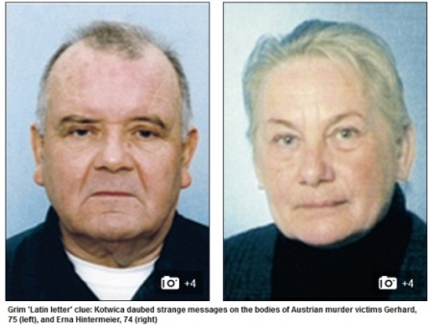
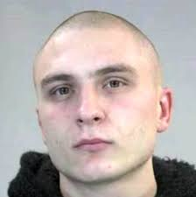
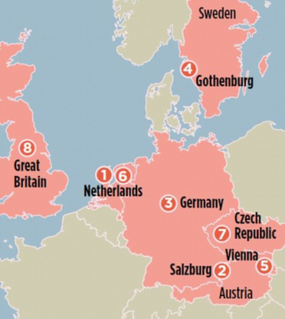
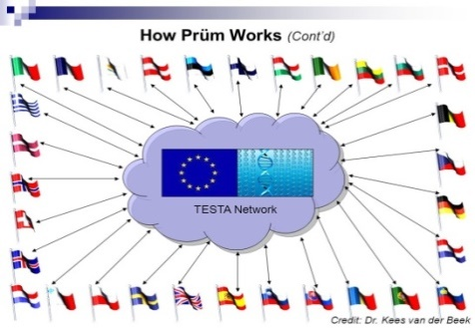
2011-2015 European Serial Murders Hit occurred late 2015
3rd Place Case
Suspect
Arrested June 8, 2015
Gerhard & Erna Hintermaster
Murdered May 21, 2015
Vienna, Austria
Left mark on body expressing joy from torture
Prüm Network
Tied to murder in Sweden
Other crimes pending
Suspect awaiting trial
No match in Austria database, but hit in Dutch database through Prüm

Slide 15
TOP TWO FINALISTS
China
Italy

Slide 16
THE WINNER
Italy

Slide 17
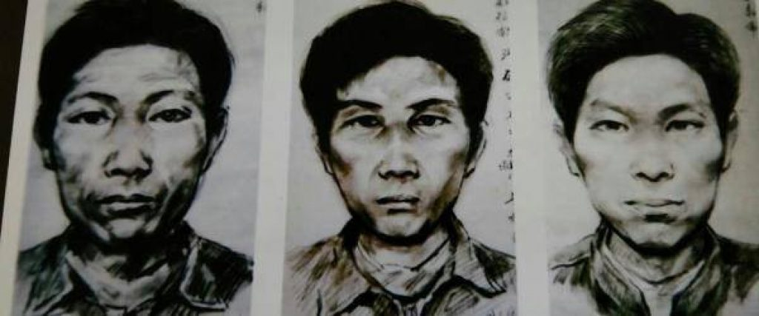
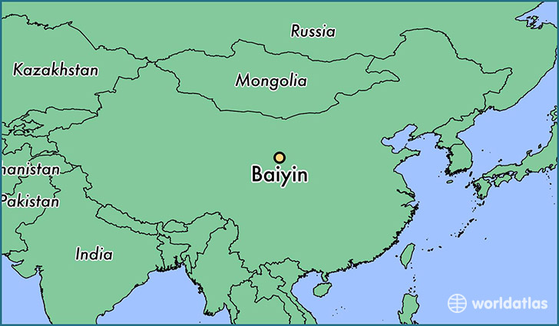
1988-2002 Serial Murders Baiyin, China – Suspect arrested August 2016
2nd Place Case
Ten young women and one child murdered between 1988 – 2002
Killer targeted women wearing red
Killer mutilated victims’ reproductive organs
Called the “Chinese Jack the Ripper” by authorities

Slide 18
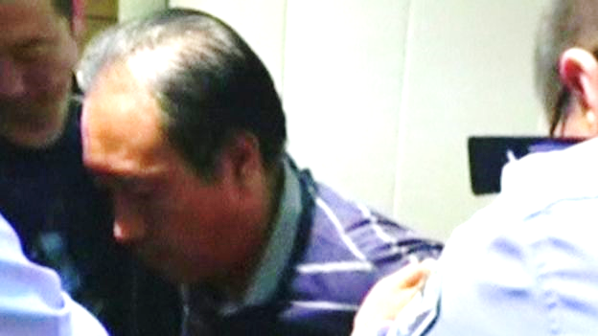
Aggressive use of Y-STRs cracks the case Full Y-STR profiles collected from many criminal offenders Pedigree trees created from multiple cities by collecting one sample from each male lineage
Man arrested for minor crime
Full Y-STR panel tested for database
Familial match identifies arrestee as relative of murderer
Gau Chengyong
Arrested August 2016 – Confessed to crimes
“Without collecting the full panel of Y-STRs from relative, this case may not have been solved”
Authorities say full YSTR panels are the key to familial hit in these cases

Slide 19
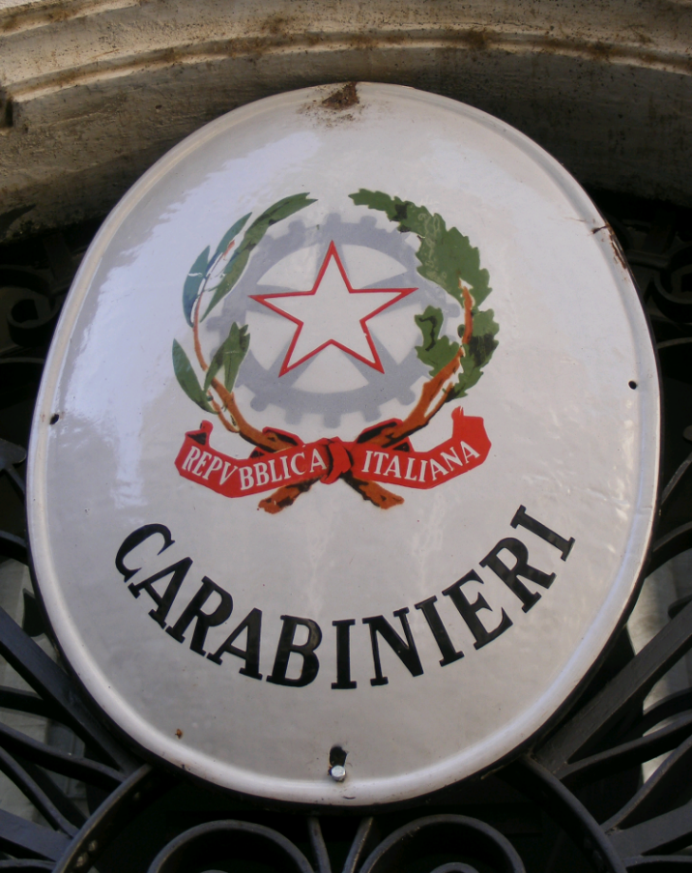
2010 Murder of Yara Gambirasio Brembate di Sopra, Italy
HIT OF THE YEAR

Slide 20
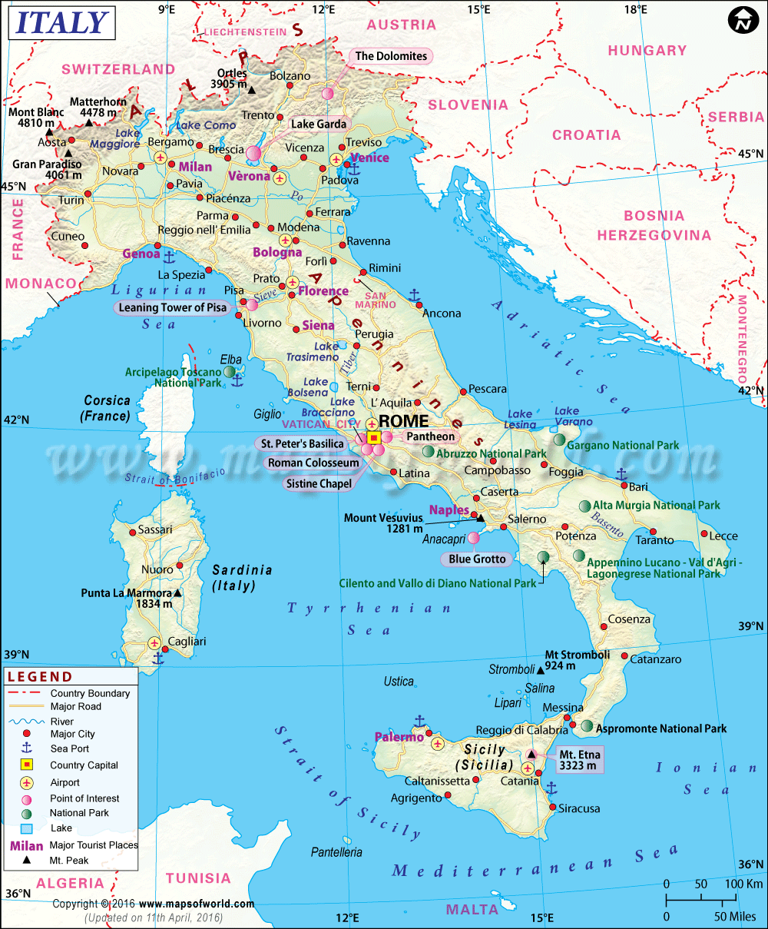
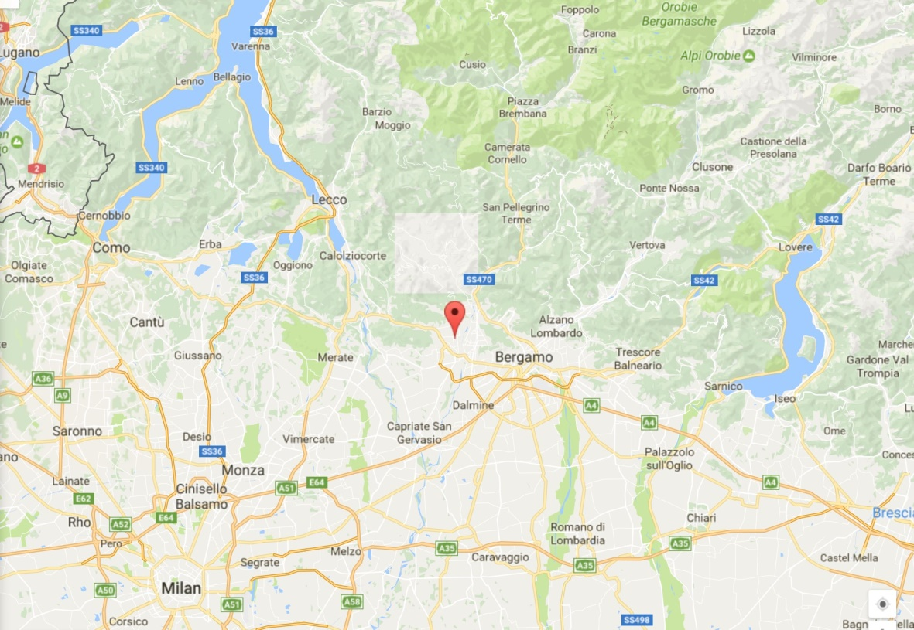
Brembate di Sopra, Italy

Slide 21
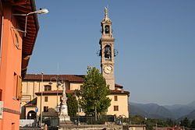
Brembate di Sopra, Italy
Brembate di Sopra
Bergamo

Slide 22
Yara Gambirasio

Slide 23
Yara Is Missing – 26 November, 2010

Slide 24
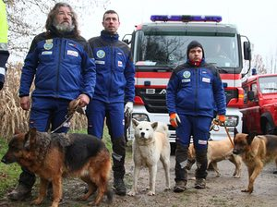
Yara’s body found 26 February, 2011

Slide 25
The Evidence at the Crime Scene
Full STR profile found in underwear
Find who belongs to the profile

Slide 26
Largest mass screen ever conducted
(Spring 2011 – Summer 2012)
15,000 samples
No Direct Hits
Familial Hit
Summer 2012

Slide 27
Familial match to
Young Man
from mass screening
Father?
NO MATCH
NO MATCH
9 living siblings of Young Man’s father
One deceased
sibling to father of
Young Man
Giuseppe
Died in 1999
No DNA readily available

Slide 28
Giuseppe
3 KNOWN children
Conclusion: Suspect is a child born out of wedlock
Find the mother, identify the suspect

Slide 29
CHALLENGE:
FIND THE MOTHER
Community not talking
Family members not aware of a child born out of wedlock
Second mass screening:
532 women
(Fall 2012 – Winter 2014)
MATCH: Ester
Winter 2014

Slide 30
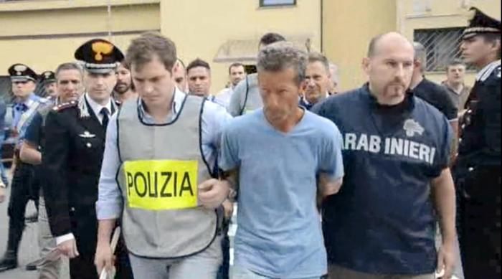
3 known children
Ester
Massimo Bossetti Arrested
June 16, 2014
Drunk Driving road block to collect suspect’s DNA (breathalyzer test)

Slide 31
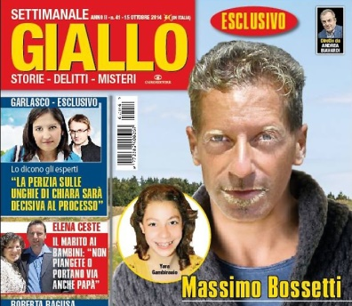
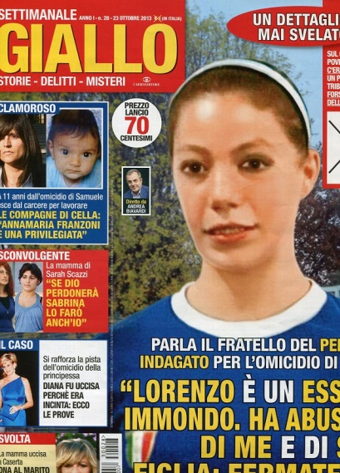
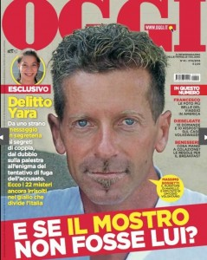
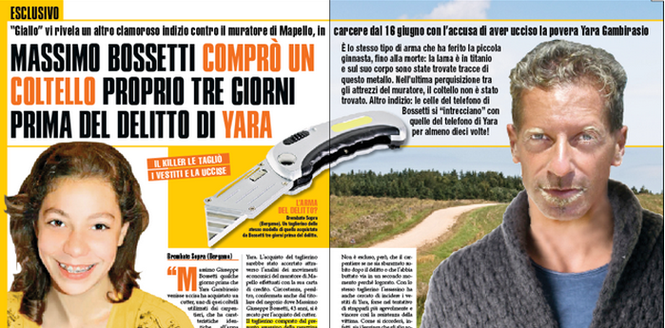
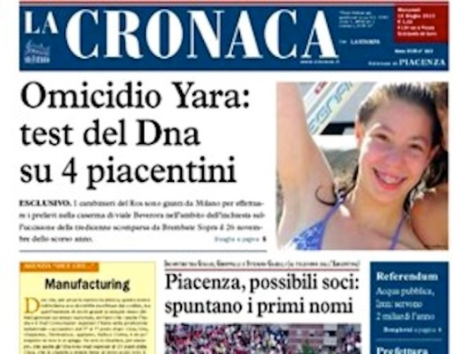
Massimo Bossetti convicted
July 1, 2016
Giallo, 9 October 2014
The Guardian, 2 July 2016
Giallo, 23 October 2013
Ultime Notizie Flash, 9 October, 2014
Oggi, 16 November 2015
La Cronaca, 15 June, 2015

Slide 32
Acknowledgements
Rock Harmon
Senior Deputy District Attorney
Alameda County, California, USA (Retired)
Guilherme Jacques
Forensic Scientist
National Institute of Criminalistics
Federal Police, Brazil
Dr. IR.C.P. (Kees) Vanderbeek
Custodian Dutch DNA Database
Netherlands Forensic Institute
The Hague, Netherlands
Detective Sergeant Joe Blozis
Forensic Investigations Division
New York City Police Department
New York, USA (Retired)
Vanessa Lynch
Founder and Executive Director
The DNA Project
Cape Town, South Africa
Lorna Santos
Chief
PNP Crime Laboratory DNA Branch
Philippines National Police
Kyle Schroeder
Gordon Thomas Honeywell Governmental Affairs
Hanna Jones and Lisa Hurst
Gordon Thomas Honeywell Governmental Affairs
Thermo Fisher Scientific

