Slide 1
2018
Presented by Tim Schellberg, President
Gordon Thomas Honeywell, Governmental Affairs
HIDS Conference - Rome, Italy - May 4, 2018

Slide 2
DNA Database Hit of the Year
Recognition
Awareness
Promotion

Slide 3
Awareness and Promotion of DNA Databases Create Progress
NEW database countries in 2017
Philippines
Iran
ON the way in 2018
Argentina
Guatemala
Costa Rica

Slide 4
Selecting the Winning Case
Global Announcement
Criteria:
Cold hit against a reference database; and
Hit or a conviction within the last 48 months
Sent to Forensic DNA and Police Communities
61 Cases from 14 Countries
Top 12 cases presented by GTH to 7 judges
6 Finalists selected, discussed and evaluated by judges
Only one vote separated the first and second place case

Slide 5
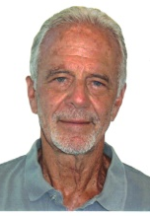
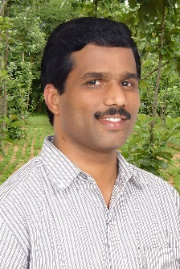
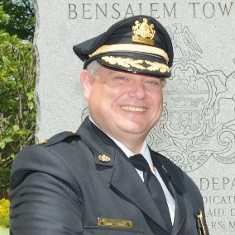
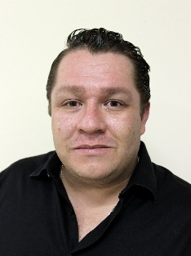
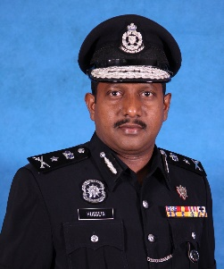
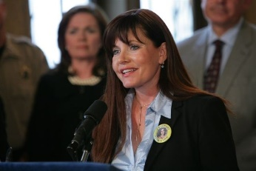
2018 Hit of the Year Judges
Rock Harmon (retired)
Senior Deputy District Attorney
Alameda County District Attorney’s Office
California, United States
Dr. Dyan Daly
DNA Database Team Manager
Forensic Science Ireland
Dublin, Ireland
Dr. Madhusudan Reddy Nandineni
Staff Scientist and Group Leader, CODIS Administrator
Centre for DNA Fingerprinting and Diagnostics (CDFD)
Hyderabad, India
Frederick Harran
Director, Bensalem Township Police Department
Pennsylvania, United States
MSc. Estuardo Solares Reyes
Genetic Lab Manager
National Forensic Science Institute of Guatemala
Guatemala City, Guatemala
Datuk Hussein Omar Khan
Principal Assistant Director
Criminal Investigation Department
Royal Malaysia Police
Kuala Lumpur, Malaysia
Jayann Sepich
Co-Founder
DNA Saves
New Mexico, United States

Slide 6
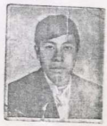
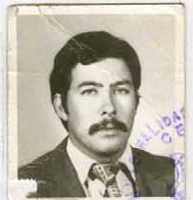
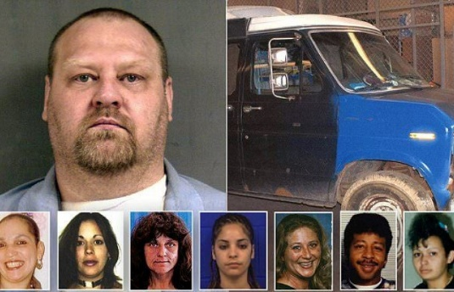
Case Submission Highlights Missing Person Cases and Programs are on the Rise 10 of 61 cases were hits to missing person databases
Guatemala - 1980’s “Death Squad Diary” Political Killing Cases
Two Identifications in 2014 and 2016
Death Squad Diary discovered in 1999. Details death of 183 pollical opponents
Identifying victims become important to validate Human Rights Court findings of government responsibility
Project focus on 40,000 missing persons. 15,000 family members have contributed to database so far.
Syria – ISIS Killings
Four decapitated bodies discovered December 2016
Kinship analysis/databasing from many consanguineous villages led to returning bodies to families in April, 2017
Four people had been kidnapped from Christian village during ISIS raid
New Britain, Connecticut, USA
Remains of seven homicides victims found.
Suspect believed to be the killer, but not charged for many years because no identification of bodies.
Once identified, suspect convicted of all homicides

Slide 7
Case Submission Highlights: Countries with recently created or smaller databases are experiencing the benefits of a national database
2013 Murder
of Protective Father
Hit occurred November 2014
Boyfriend jailed
Exonerated when other man placed into database for unrelated fraud conviction matched mystery DNA at crime scene
Suspect awaiting trail
Poland
2015 Gang Robbery in
Kuala Lumpur
Hit occurred November 2017
One of four gang members remained at large.
Accomplices were not talking.
But “who needs a rat when you have DNA”
Cigarette butt from gang hotel room identified fourth suspect
Suspect awaiting trial
Malaysia

Slide 8
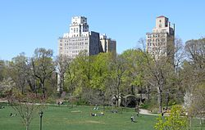
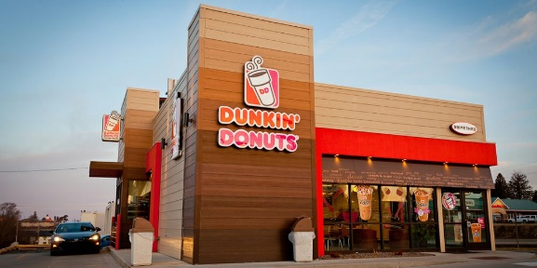
Case Submission Highlights: Vindicated and Exonerated in New York City A reminder of the power of DNA and its limitations
1994 Sexual Assault - “Fake News” Story Proven Wrong
New York City, USA
Crime occurred April 1994
Columnist claimed rape was a hoax. Police and public also doubted her story - $12 million libel suit ensued.
Rape kit in 2000 tested as part of rape kit backlog program, but a mixture prevented a profile
Test of non-rape kit evidence in 2017 produced a hit
Suspect already serving life sentence can’t face new charges due to statute of limitations.
2015 Robbery of Donut Shop
New York City, USA
Crime occurred 2015
Full profile obtained from cash register touched by criminal
DNA at crime scene produced a hit to someone in database for non-violent offense
Surveillance video clearly shows he didn’t commit the crime.
Be aware of transfer possibility
Even with DNA, all evidence and explanations must be considered.

Slide 9
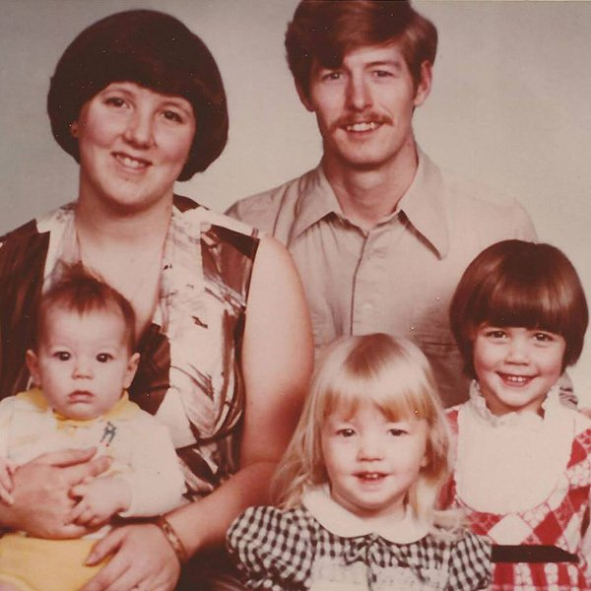
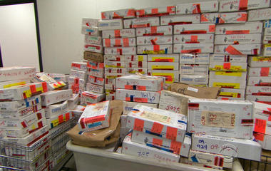
Case Submission Highlights: Complexity of mixture cases Rape kit backlogs
Murdered Mother of Three - 1978
Palmdale, California, USA
Waiting for changes to mixture technology and FBI upload restrictions
Hit occurred April, 2014
Convicted September, 2017
Investigation led to a second murder suspect and four additional homicides.
United State’s Rapid Backlog reduction programs continue to produce hits
Aggressive legislation to audit, test and track all rape kits
Detroit tested 10,000 backlogged cases and identified 811 serial offenders
Dallas, Texas – 2008 Case
20,000 in Texas - 4,000 in Dallas alone
Rape by drugging
Cold hit December 2015
Convicted February 2018
Louisville, Kentucky – 2012 Case
3090 kits found in audit
Offender, a prolific sex offender, was the fist indicted under program after July, 2017 hit
Suspect awaiting trail

Slide 10
The Six Finalists
Massachusetts,
USA
United Kingdom
China
Colorado, USA
Arizona, USA
Montenegro

Slide 11
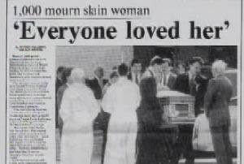
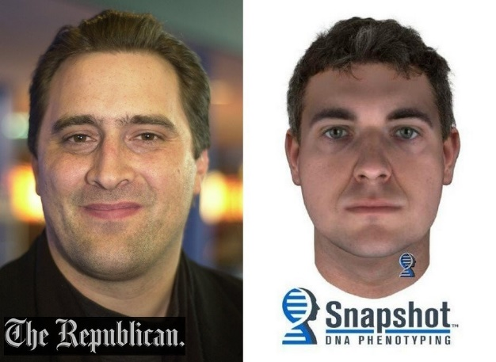
1992 Sexual Assault and Murder of Lisa Ziegert Agawam, Massachusetts
6th Place Case
Since 1992 many DNA strategies were used with no results (CODIS, Interpol, mass screens, YSTR)
In 2016 a new detective with new ideas: Phenotypic SNPs and DNA “Snapshot” to develop new leads
100 suspects eliminated based on Snap Shot
170 new leads developed and approached for mass screen
YSTR of relatives to eliminate those that did not volunteer
Primary suspect fled, but left a note confessing to crime. DNA from toothbrush matched DNA from crime scene
Suspect awaiting court action

Slide 12
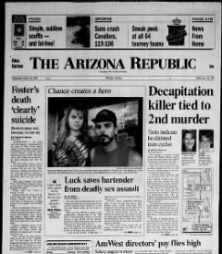
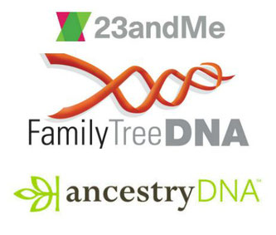
Sexual Assault and Murder of Angela Brosso (1992) and Melanie Bernas (1993) Phoenix, Arizona Hits in 2015
5th Place Case
Both victim’s bodies mutilated (one decapitated). DNA found at both crime scenes, but case goes cold for over 20 years
In 2014, Phoenix Police officers attended a forensic DNA conference and learned about YSTR technology.
This knowledge led anonymously submitting crime scene YSTR markers to public domain relative searching web site.
YSTRs matched the Miller family
5 Millers were part of the 2000 list of suspects.
One Miller matched the FBI’s psychological profile. His DNA was clandestinely obtained and matched the crime scene DNA from both cases
Suspect is currently awaiting trial
Bold
Creative
Controversial

Slide 13
2015 and 2016 assassinations of crime family members Budva, Montenegro Hits occurred 2016 and 2017
4th Place Case
October, 2015 - Hit man sneaks through Montenegrin border to kill crime boss while dinning at his restaurant in the Old Town of Budva. High powered sniper rile used.
Firearm trajectory techniques used to pinpoint where to swab wall from building across the street.
Interpol “Gateway” hit to Bosnian in the Austrian offender database arrested for drug crimes.
October, 2016 – Cousin of first victim also assassinated. DNA from banknotes used to buy get away car matched to offender in the Montenegrin database.
Both suspects are in custody and awaiting court action

Slide 14
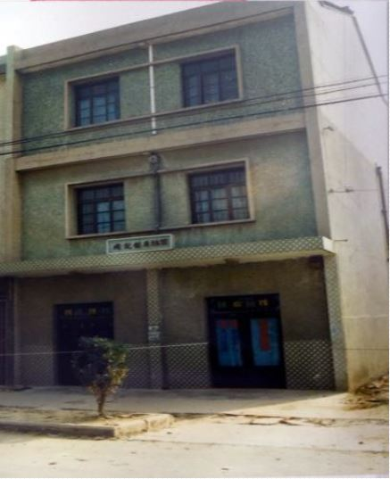
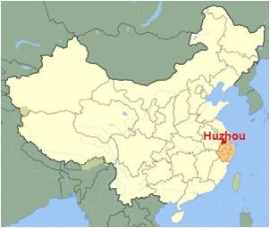
1995 murder of 4 people during hotel robbery by two men Huzhou, China - Hits in 2017
3rd Place Case
22 years after murder, case reopened as part of cold case review campaign in Zhejiang Provence.
The Evidence: 10 DNA profiles from 26 cigarette butts
The process of reducing the 10 profiles down to the profiles of the suspects
3 victims, 1 previous guest, 2 database hit exclusions
Familial search of remaining profile against China’s 50 million offender database. One profile produced a candidate list of 19,000 with 925 coming from Anhui Province
China’s YSTR program applied to Anhui Province - identifies Liu family by obtaining YSTRs in over 2000 villages
Lui family had 200 members and 6 branches. Mass screen of family conducted, which led to the arrest of Liu Yongbiao in August, 2017
Liu named second suspect. Both have confessed and are awaiting further court action
Liu Yongbiao is a famous author in China and has written fictional stories about criminals that get away with murder

Slide 15
TOP TWO FINALISTS
Colorado, USA
United Kingdom

Slide 16
2018 DNA Hit of the Year
UNITED KINGDOM

Slide 17
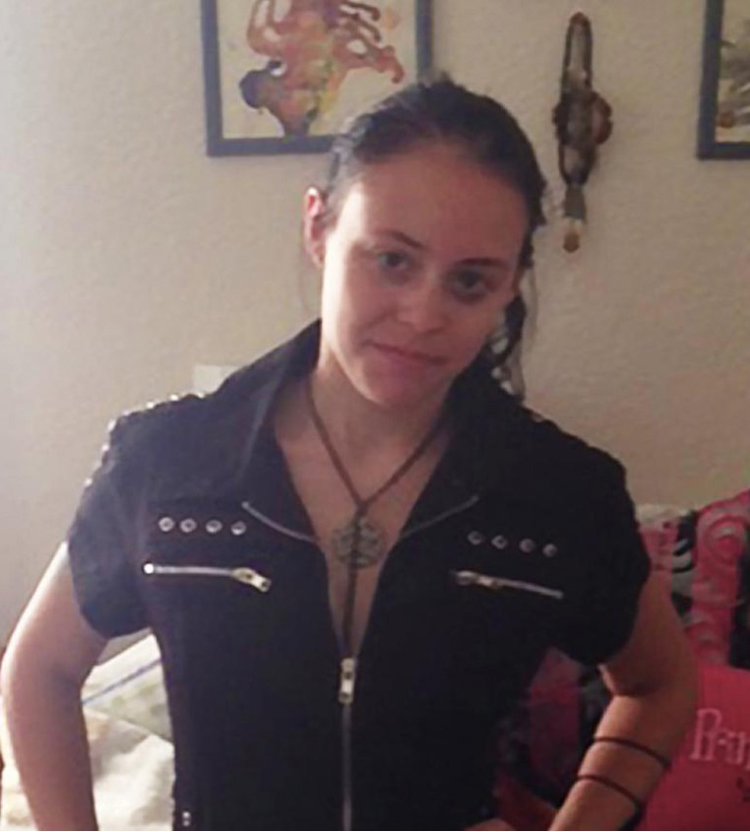
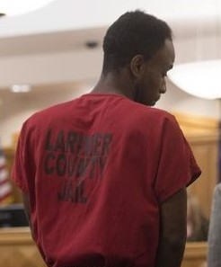
2nd Place Case
2017 Sexual Assault and Murder of Heather Hoffman Fort Collins, Colorado Hit occurred June, 2017
Institutional Precision
Speed
Confidence

Slide 18
2nd Place Case
June 21, 2017
Young Mother abducted, sexually assaulted and murdered.
June 24, 2017
DNA evidence submitted to lab
June 26, 2017
Crime lab develops full profile. No hits in state database. 11 suspects immediately exonerated.
June 28, 2017 (morning)
Profile searched against FBI national database. Hits to offender in Kentucky database for child pornography conviction.
June 28, 2017 (evening)
Suspect arrested
January 2018
Suspect pleads guilty to murder.
S P E E D
“This is the way DNA databases are supposed to work” - Jayann Sepich, Co-Founder, DNA Saves and 2018 DNA Hit of the Year Judge
The State of Colorado is well known in the United States as having one of the best DNA programs in the country.

Slide 19
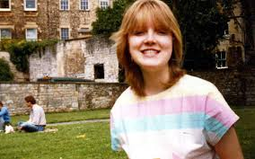
1984 Sexual Assault and Murder of Melanie Road Bath, United Kingdom
HIT OF THE YEAR

Slide 20
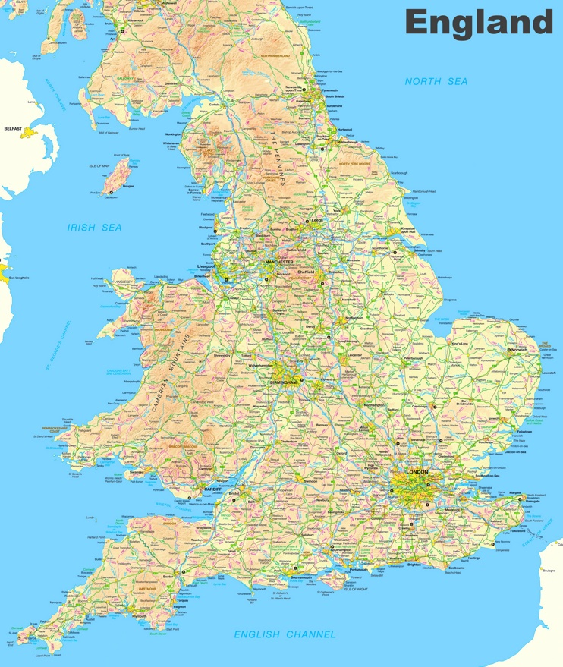
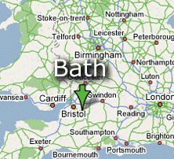
Bath, United Kingdom

Slide 21
Bath, United Kingdom

Slide 22
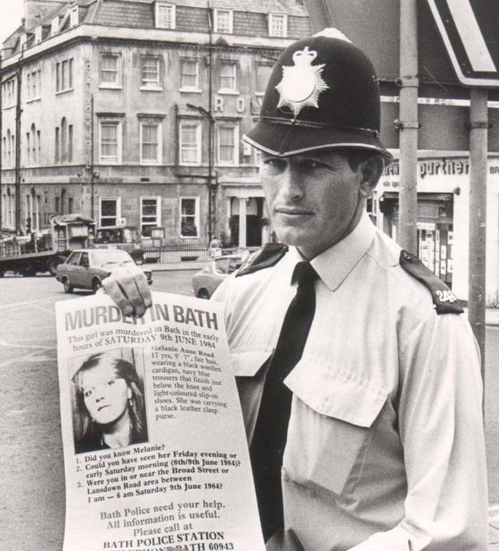
Melanie was Sexual Assaulted and Murdered on
9 June, 1984
Attacked while walking home at night
Only 200 meters from house
Sexual Assaulted
Fought for her life – caused significant amount of offenders blood to be collected
Brutally murdered - Stabbed 26 times

Slide 23
The Evidence at the Crime Scene
Primary Evidence: Attacker’s Blood
Meticulous blood Swabbing due to blood type focus in 1984

Slide 24
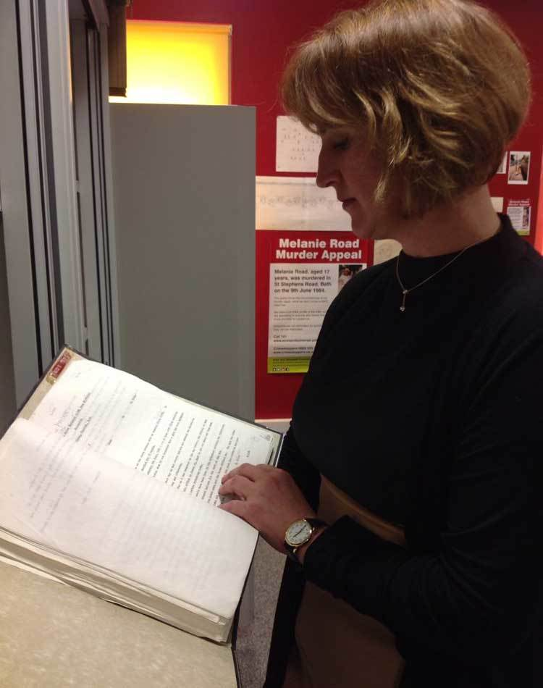
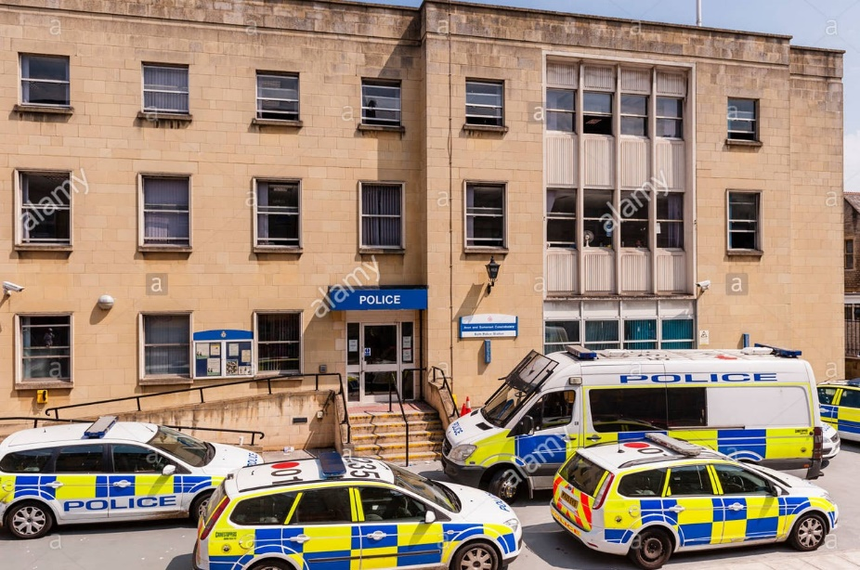
Committed Police with a Never Give up Attitude
One of UK’s Most Aggressive Criminal Investigations Ever (1984-2016)
25,744
documents linked to the case
3,000
Crime scene exhibits
1,080
voluntary swabs given
Lead case detective Julie Mackay,
2009-2016
2,555
people who were forensically eliminated
95
arrests made in the case
1,410
calls from members of the public
7,723 investigative actions or inquiries

Slide 25
The DNA Story behind the Melanie Road Case
1995
2011
2013
Creation of UK DNA Database. Crime scene DNA profiled and uploaded –
No Hits
Becomes one of the UK’s first cases to go through familial searching process –
No usable results
Second familial search approved. Geographic analytics utilized. Candidate list reduced, but still no usable results.
Continuous Mass Screenings and elimination sample testing –
1,080 samples collected and profiled

Slide 26
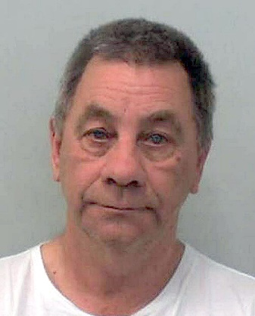
The DNA Story behind the Melanie Road Case
2014
March 2015
June 2015
Daughter of offender gets Criminal “infraction” for breaking a necklace during a domestic dispute – Under UK’s aggressive DNA testing law, she is added to the database.
Third familiar search approved. Using geographic analytics, only 200 candidates and daughter is first on the list.
Police approach offender to provide a DNA sample. It’s a perfect match to crime scene DNA. Christopher Hampton is arrested.

Slide 27
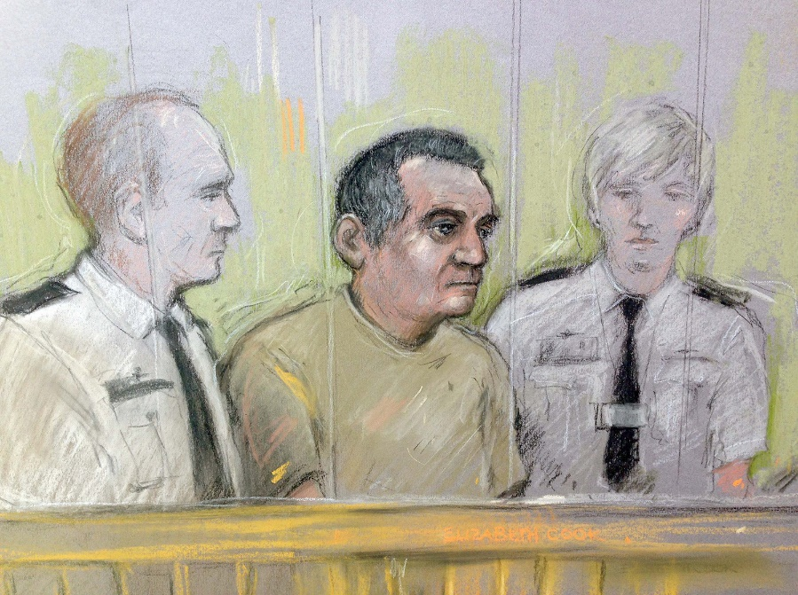
The DNA Story behind the Melanie Road Case
May 2016
Christopher Hampton pleads guilty and will spend rest of his life in prison

Slide 28
Acknowledgements
Avon & Somerset, United Kingdom Constabulary
Detective Julie MacKay
Detective Gary Mason
Cellmark Forensics
Forensic Scientist Mike Wheelhouse, Cellmark Forensics
DNA Hit of the Year Judges
Frederick Harran
Director, Bensalem Township Police Department
Pennsylvania, United States
MSc. Estuardo Solares Reyes
Genetic Lab Manager
National Forensic Science Institute of Guatemala
Guatemala City, Guatemala
Datuk Hussein Omar Khan
Principal Assistant Director
Criminal Investigation Department
Royal Malaysia Police
Kuala Lumpur, Malaysia
Jayann Sepich
Co-Founder
DNA Saves
New Mexico, United States
Kyle Schroeder
Gordon Thomas Honeywell Governmental Affairs
Hanna Jones
Gordon Thomas Honeywell Governmental Affairs
Thermo Fisher Scientific
Rock Harmon (retired)
Senior Deputy District Attorney
Alameda County District Attorney’s Office
California, United States
Dr. Dyan Daly
DNA Database Team Manager
Forensic Science Ireland
Ireland
Dr. Madhusudan Reddy Nandineni
Staff Scientist and Group Leader, CODIS Administrator
Centre for DNA Fingerprinting and Diagnostics (CDFD)
Hyderabad, India

